Slide 1
Notes:
Last updated August 2020

Slide 2
IMPORTANT DATES
Meet the Team: Thursday, August 25
1st-3rd: 6:00-6:20 pm
4th-6th: 6:30-6:50 pm
Practices begin: August 29
Games Begin: September 17
Last Game: November 5
Deadline to request award medals: October 15
Notes:
Page 2 of Handbook

Slide 3
EXPECTATIONS
Grow in the knowledge, skills and passion for stewarding players to Christ through the sport of volleyball
Be purposeful when coaching
Be a positive role model
Dress Code
Assistant/Substitute Coaches
Notes:
Grow: When you coach, we want you to instill character in the players.
Purposeful: As you coach, teach your players about the truths of God – He loves us and wants to know us.
Role Model: Encourage and respect your players. They are watching you far more than you know.
Dress Code: Please remind your players no tank tops, crop tops, spaghetti straps; no spandex/compression shorts, leggings, unless covered by athletic shorts. Coaches, no spandex, leggings, compression pants unless covered by visible athletic shorts. Player is required to wear the uniform shorts issued with uniform.
Assistant Coaches: Recruit coaches, fill-ins must be approved! They have to fill out an application, pass a background check, and take a ministry safe course. If you are going to be out and do not have an assistant, recruit one or let us know and an intern will fill in for you.

Slide 4
RESPONSIBILITIES
Attend Coaches’ Training
Contact Your Team (example pg. 11)
Attend ‘Meet the Team’ (pg. 4)
Conduct Practices (pg. 9)
Coach Games (pg. 10)
Award End-of-Year Medals (pg. 5)
Notes:
Contact Your Team: Before ‘Meet the Team’. Send emails or make phone calls. Ask for a response to your emails. If you don’t received a response, make a phone call.
Meet the Team: Introduce yourself, make sure you have their correct contact information, tell them when & where practices are, tell what to bring to practices (knee pads, water), let them know the dress code, ask for volunteer help, hand out team rosters.
If you and your assistant will not be at Meet the Team, please let your team & us know!
Conduct Practices: Be prepared with drills that teach. Positive reinforcement only. No scrimmaging the first two weeks of practice. KNOW your devotions. Make them relatable and personal! The kids will know when your faking it! Remember, this may be the only time they ever hear about Jesus! Don’t miss this opportunity!
Coach Games: Have your lineup & captains ready. Make sure everyone gets equal start time/play time. Be involved from the sideline. Cheer them on from the bench. Be an encourager, always have uplifting words for them!
Awards End-of-Year Medals: Given at the end of the season (no buttons every game). Highlight your player’s strength. Not a most improved or MVP. Players can have the same award. 10 Category Choices – page 5. You must turn in your list by the deadline or you will not have medals.

Slide 5
COMMUNICATION
Make sure you have the correct phone numbers and email address for each parent
Verify someone is assigned to snack duty for each week
Recruit help for calling lines during the games
Send a weekly email to the team / parents regarding game times. (pg. 11)
You can never give them too much information!!
Notes:
Snack duty: Make a spreadsheet for the team meet and greet with each week on there and let the parents sign up then. Any emails you send, you can attach the sign-up sheet to the email as a reminders.
Game Day Line Callers: Each team is responsible for providing someone to call lines during the game. It can be a teenager. You can add this responsibility to your snack sign-up.

Slide 6
REMINDERS
Devotions during practice at half-time. Intern will announce balls down. Devotions should take 5-8 minutes. Be prepared for devotion!
Positive reinforcement only! No push-ups, burpees, etc.
No chanting during the opposing team’s serve.
Each team needs to recruit someone to call lines during the game (4th-6th grade)
Zone Serving (pg.8, pg. 12)
Do not argue with the referee
Notes:
-Be prepared for the devotions. Bring your bible and let the players see you reading out of it. It is impactful. Remember, you may be the only person who shares Jesus with them. Make the devotion personal and relatable. Apply it to home, school, volleyball. They should only take about 5-8 minutes. However, if you have some deep meaningful conversations going on, then continue. Move off to the side of the court so the other team can continue their practice.
-Positive reinforcement only.
-Don’t forget to recruit a volunteer to call lines during the game (one from each team). This can be a teenager. I would add this to the weekly email you send out; I might even treat it like the snacks and have a sign-up list.
-Overhand serves: 1st-3rd grade – behind the 30 ft line; 4th-6th grade – 25 ft or 30 ft line

Slide 7
REMINDERS, continued
Wait outside the gym until your practice time
No scrimmaging first two weeks of practice
Time outs – one per game
Lifts are called
Please do not leave the court between games
Foot Faults (both courts)
Equal play time
Server rotates in to serve
Notes:
-Wait outside the gym until your practice time. This should help with distractions/interruptions. Please tell your parents!
-No scrimmaging the first 2 weeks of practice. We have three practices prior to the first game so you will be able to get in one scrimmage before your first game.

Slide 8
CLARIFICATIONS - 2022 SEASON
Projector – in bounds/out of bounds
Overhand serves
Foot faults are called – both courts
Lifts – obvious, open-hand lift
Zone serving
Must rotate in to serve
3rd game will have a coin toss, again
Center line violations called (4th – 6th grade)
Notes:
Projector – stays on sides, still playable; goes over the net, considered out of bounds
Overhand serves – 30 ft line for littles; 25 ft line for bigs. Can’t begin with overhand @ 25 ft then switch to 30 ft in the same service.
Zone serving – if you are asked to move your player back, please do so
If you didn’t win the coin toss, your first server will rotate onto the court.

Slide 9
BE PRAYED UP
This will be challenging.
This will be rewarding.
The players will have questions you may not be ready for or know how to answer.
Parents may complain. If you run into this type of situation, please let us know.
WE ARE PRAYING FOR YOU!
Notes:
A key to limiting parent complaints is communication.
Picture day schedules: be sure each parent has been contacted regarding time and location of pictures. Make sure they understand that the time listed for pictures is when they start snapping, not when to show up. Tell them to show up 10-15 minutes before!

Slide 10
Coaches’ Clinic

Slide 11
GENERAL RULES OF VOLLEYBALL
Ball that lands on the line is in.
Serve that does not go over the net is a point for the other team.
Ball that lands out is a point.
Serve that strikes the net and goes over is a live ball.
Serve that strikes the antennae is out.
Ball in play that strikes the ceiling/basketball goal/sound equipment but remains on your side is a live ball.
Ball in play that strikes the ceiling/basketball goal/sound equipment and goes over the net to the opposing team is considered obstructed and a dead ball; point for the other team.
Notes:
Pg. 6

Slide 12
RULES SPECIFIC TO CENTRAL SPORTS
1st – 3rd Grade: 4th-6th Grade:
Game 1 is 18 min Game 1 to 25 points
2 minutes break Game 2 to 25 points
Game 2 is 18 min Game 3 to 15 points
*games must be won by 2 pts
Player rotates in at server position only and rotates through all positions on the court.
Player may not serve more than 3 points in a row.
Rally scoring
Zone serving
Serve that is missed (‘whiffed’) is replayed.
Lifts called (referee’s discretion)
One time out per set
Game Day Outline (pg. 10)
Notes:
If the games go long, be patient! If it was your team playing that was going to three and a little long, you would not want it cut off.

Slide 13
END-OF-YEAR AWARDS
Given at the end of the year
Highlights your player’s strength
Multiple players can receive the same medal
Categories: Offense, Defense, Passing, Serving, Hustle, Sportsmanship, Leadership, Character, Effort, Encourager
You must turn in your medal count to familyactivities@centralbcs.org by October 15 !

Slide 14
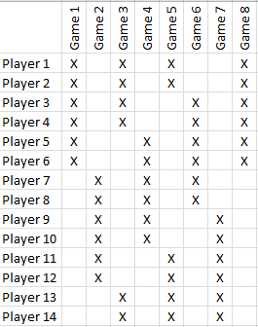
PLAY TIME/LINE-UP ROTATION
Every player rotates in at server and rotates through all positions to ensure equal play time.
Evenly divide games starts & captains (coin toss callers); as much as is possible.
During 2nd & 3rd games, you can restart your line-up, begin where you left off or use a new line-up; be consistent.
If a player is late, you can either have them sit until they come up in the line-up or you can slide them in on the next rotation; be consistent.
Notes:
-Equal Play Time/Line-up Rotation: as much as is possible, evenly divide games starts, coin toss callers (captains).

Slide 15
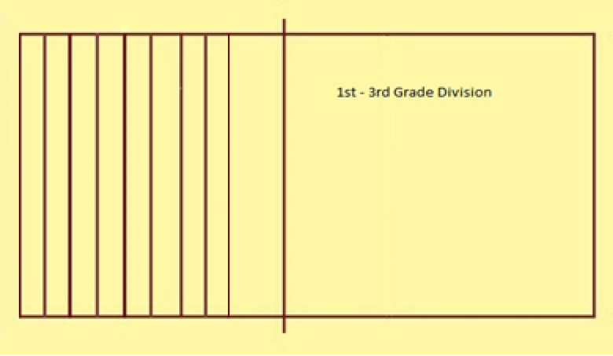
ZONE SERVING – 1ST – 3RD
Lines are 2.5ft apart
Players may start in front of 10ft line
After two successful serves, they move back one zone for the third serve.
When the player rotates around for the next serve, they start in the last zone in which they were successful.
Foot faults called.
Notes:
12 serving zones
Each player should begin in a zone that is the furthest from the net from which they can consistently, successfully serve.
Reasoning – Get the girls to move back (they get locked into a spot; this will help you as a coach to prove to them they can move further back and be successful); clear defined start area

Slide 16
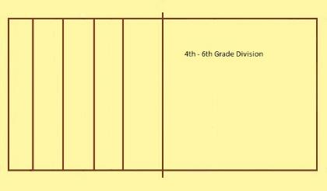
ZONE SERVING – 4TH – 6TH
Lines are 5ft apart
Players may start at the 10ft line
After EACH successful serve, they move back one zone.
When the player rotates around for the next serve, they start in the last zone in which they were successful.
Foot faults called.
Notes:
5 serving zones
Each player should begin in a zone that is the furthest from the net from which they can consistently, successfully serve.

Slide 17
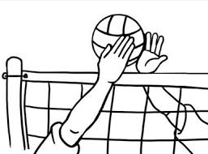
TECHINCAL VOLLEYBALL SKILLS/DRILLS
-Ready Position
-Player positioning
-How to serve
-How to pass
-How to set

Slide 18
READY POSITION
-Legs shoulder width apart with knees bent.
-Weight on you toes and ready to move towards the ball.
-Arms out in front instead of on your knees.
-Be ready to pass the ball if it comes to you.
Notes:
Teach them the proper Ready position. Hands apart, knees bent, move to the ball, use legs to rise up, moving arms minimally. This is one of the hardest things to get them to learn!
Don’t pass/toss the ball to them; make them move their feet
T-shirt drill (littles & bigs)
Laying on floor drill (bigs)

Slide 19
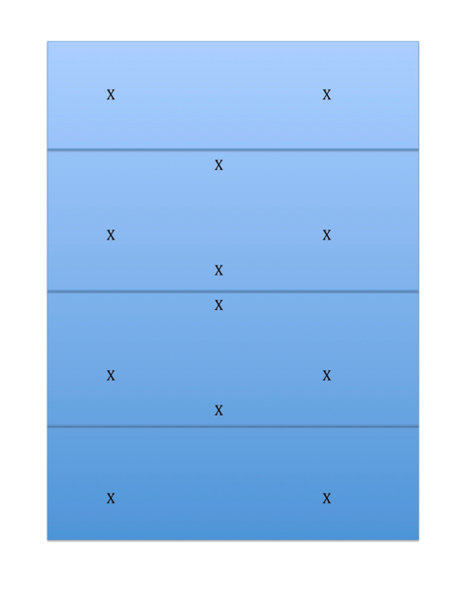
PLAYER POSITIONING
Serving Position
Net
Serving Position
Notes:
Teach them where to enter the court. How to rotate around the court. How to rotate off the court. Also, for the bigs, have them learn to rotate from both sides of the court (cross-court serve).

Slide 20
Game 1
Roster
Sally
Julie
Lauren
Annette
Lucy
Stacey
Robby
Susan
Melanie
Sara
7) Robby (1st in line)
8) Susan
9) Melanie
10) Sara
1) Sally 3) Lauren
2) Julie
6) Stacey
4) Annette
5) Lucy
X
X X
X
X X
Notes:
Please feel free to teach them offense and defensive positioning on the court; this helps with foot movement. Have them call “mine”.

Slide 21
Game 1 (Rotations)
Roster
Sally
Julie
Lauren
Annette
Lucy
Stacey
Robby
Susan
Melanie
Sara
7) Robby (1st in line)
8) Susan
9) Melanie
10) Sara
1) Sally 3) Lauren
2) Julie
6) Stacey
4) Annette
5) Lucy
X
X X
X
X X

Slide 22
Game 2
Roster
Sally
Julie
Lauren
Annette
Lucy
Stacey
Robby
Susan
Melanie
Sara
9) Melanie
6) Stacey (1st in line)
5) Lucy
4) Annette
3) Lauren
7) Robby
8) Susan
2) Julie
10) Sara
1) Sally
X
This is where the player in right back from the first game will play in the second game.
X X
X
X X

Slide 23
Game 2
Roster
Sally
Julie
Lauren
Annette
Lucy
Stacey
Robby
Susan
Melanie
Sara
9) Melanie
6) Stacey (1st in line)
5) Lucy
4) Annette
3) Lauren
7) Robby
8) Susan
2) Julie
10) Sara
1) Sally
X
Middle front is the area the players should aim to pass the ball to.
X X
X
X X

